Slide 1
Session 5
White-Box Testing (cont.)
chengbaolei@suda.edu.cn

Slide 2
3.6 Data Flow Testing
The data flow testing method selects test paths of a program according to the locations of definitions, uses and deletions of variables in the program
Data flow testing is a powerful tool to detect improper use of data values due to coding errors
  Incorrect assignment or input statement
  Definition is missing (use of null definition)
  Predicate is faulty (incorrect path is taken which leads to incorrect definition)
Notes:
Need to focus some testing effort on these as well (not a focus of coverage-based testing)
– Explore the sequences of events related to the data state and the
unreasonable things that can happen to data.
– Explore the effect of using the value produced by each and every
computation

Slide 3
Variable Definitions and Uses
A program variable is DEFINED when it appears:
  on the left hand side of an assignment statement (e.g., Y := 17)
  in an input statement (e.g., input(Y))
  as an OUT parameter in a subroutine call (e.g., DOIT(X:IN,Y:OUT))
  将数据存储起来, 存储单元的内容改变

Slide 4
Variable Definitions and Uses
A program variable is USED when it appears:
  on the right hand side of an assignment statement (e.g., Y := X+17)
  as an IN parameter in a subroutine or function call (e.g., Y := SQRT(X))
  in the predicate of a branch statement (e.g., if X>0 then...)
  将数据取出来，存储单元的内容不变

Slide 5
Variable Definitions and Uses
Use of a variable in the predicate of a branch statement is called a predicate-use (“p-use”). Any other use is called a computation-use (“c-use”).
For example, in the program statement:
If (X>0) then
print(Y)
end_if_then
there is a p-use of X and a c-use of Y.

Slide 6
Variable Definitions and Uses
A variable can also be used and then re-defined in a single statement when it appears:
  on both sides of an assignment statement (e.g., Y := Y+X)
  as an IN/OUT parameter in a subroutine call (e.g., INCREMENT(Y:IN/OUT))

Slide 7
3.6 Data Flow Testing
Variables that contain data values have a defined life cycle: defined, used, killed (destroyed).
The "scope" of the variable
      { // begin outer block
      int x; // x is defined as an integer within this outer block
      ...; // x can be accessed here
      { // begin inner block
      int y; // y is defined within this inner block
      ...; // both x and y can be accessed here
      } // y is automatically destroyed at the end of this block
      ...; // x can still be accessed, but y is gone
      } // x is automatically destroyed

Slide 8
3.6 Data Flow Testing
Three possibilities exist for the first occurrence of a variable through a program path:
  ~d - the variable does not exist (indicated by the ~), then it is defined (d)
  ~u - the variable does not exist, then it is used (u): c-use / p-use
  ~k - the variable does not exist, then it is killed or destroyed (k)
Notes:
The first is correct. The variable does not exist and then it is defined. The second is incorrect. A variable must not be used before it is defined. The third is probably incorrect. Destroying a variable before it is created is indicative of a programming error.
d – defined, created, initialized
Data declaration; on left hand side
of computation
k – killed, undefined, released
u – used for something (=c and p)
c - Right hand side of
computation, pointer (calculation)
p - Used in a predicate (or as
control variable of loop)

Slide 9
3.6 Data Flow Testing
List 9 pairs of defined (d), used (u), and killed (k):
  dd - Defined and defined again—not invalid but suspicious. Probably a programming error.
  du - Defined and used—perfectly correct. The normal case.
  dk - Defined and then killed—not invalid but probably a programming error.
  ud - Used and defined—acceptable.
  uu - Used and used again—acceptable.
  uk - Used and killed—acceptable.
  kd - Killed and defined—acceptable. A variable is killed and then redefined.
  ku - Killed and used—a serious defect. Using a variable that does not exist or is undefined is always an error.
  kk - Killed and killed—probably a programming error
Notes:
- dd – why define twice without use?
- du – normal (a “du pair”)
- dk -- why define and kill without use?
- ud – usually normal, reassignment after use
- uu – normal
- uk – normal
kd – normal (kill then redefine)
ku – a bug; killed then used
kk – harmless but probably a bug
Often these anomalies are caught by compilers or static analyzers today – depending upon the language

Slide 10
3.6 Data Flow Testing
A data flow graph is similar to a control flow graph in that it shows the processing flow through a module.
In addition, it details the definition, use, and destruction of each of the module's variables.
Technique
  Construct diagrams
  Perform a static test of the diagram
  Perform dynamic tests on the module
Notes:
First, we will perform a static test of the diagram. By "static" we mean we examine the diagram (formally through inspections or informally through look-sees). Second, we perform dynamic tests on the module. By "dynamic" we mean we construct and execute test cases

Slide 11
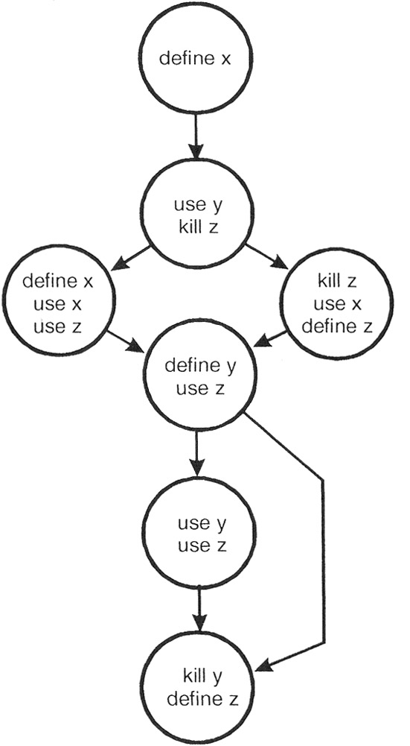
3.6 Data Flow Testing
  For each variable within the module we will examine define-use-kill patterns along the control flow paths.
Notes:
First, we will perform a static test of the diagram. By "static" we mean we examine the diagram (formally through inspections or informally through look-sees). Second, we perform dynamic tests on the module. By "dynamic" we mean we construct and execute test cases

Slide 12
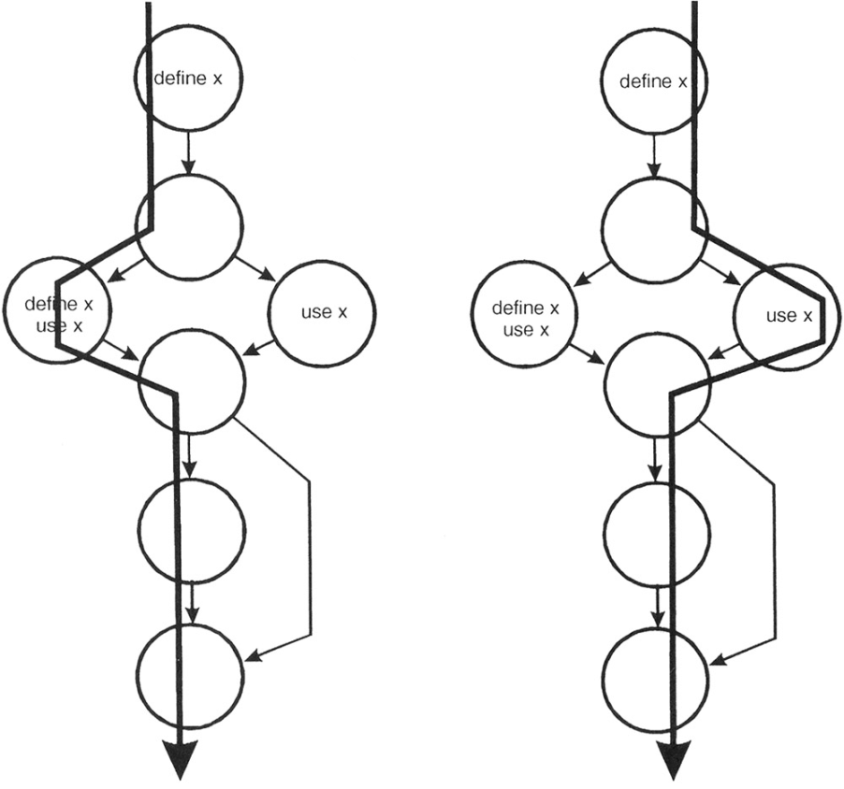
3.6 Data Flow Testing
  The define-use-kill patterns for x (taken in pairs as we follow the paths) are:
    ~define - correct, the normal case
    define-define - suspicious, perhaps a programming error
    define-use - correct, the normal case

Slide 13
3.6 Data Flow Testing
  Exercise:
    List the define-use-kill patterns for y and z (taken in pairs as we follow the paths)

Slide 14
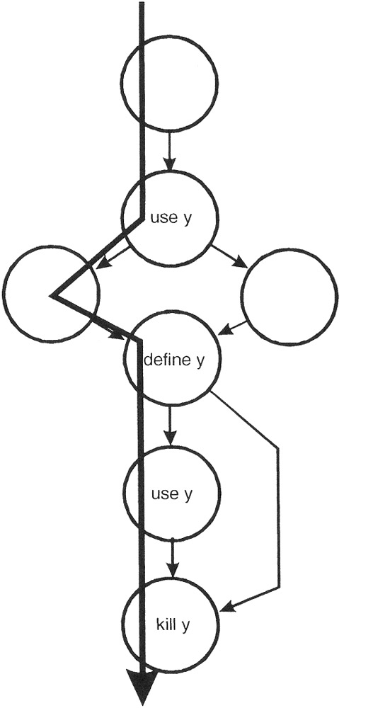
3.6 Data Flow Testing
  The define-use-kill patterns for y (taken in pairs as we follow the paths) are:
    ~use - major blunder
    use-define - acceptable
    define-use - correct, the normal case
    use-kill - acceptable
    define-kill - probable programming error

Slide 15
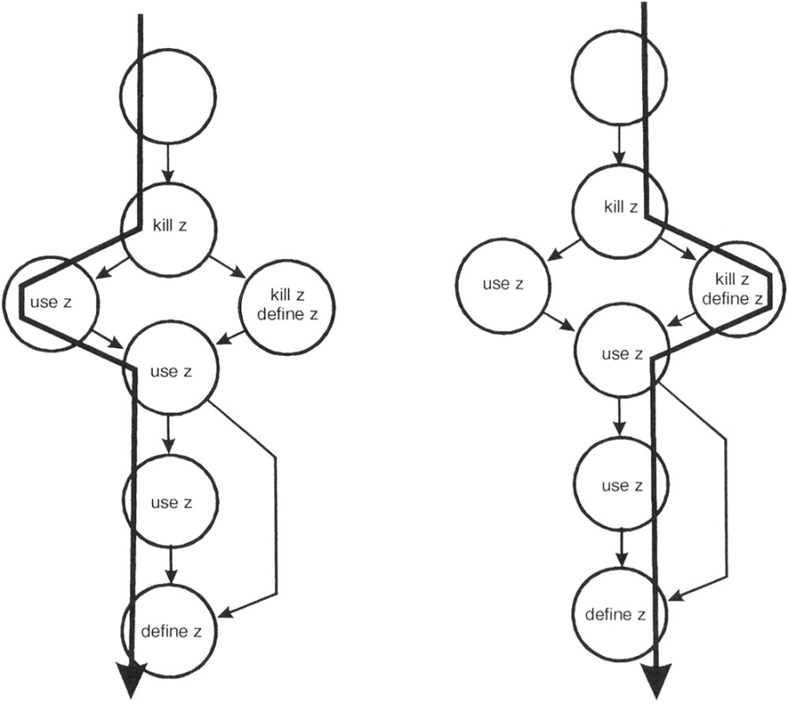



3.6 Data Flow Testing
  The define-use-kill patterns for z (taken in pairs as we follow the paths) are:
    ~kill - programming error
    kill-use - major blunder
    use-use - correct, the normal case
    use-define - acceptable
    kill-kill - probably a programming error
    kill-define - acceptable
    define-use - correct, the normal case

Slide 16
3.6 Data Flow Testing
In performing a static analysis on this data flow model the following problems have been discovered:
    x: define-define
    y: ~use
    y: define-kill
    z: ~kill
    z: kill-use
    z: kill-kill

